Slide 1
2025 Orchard HOA Annual Meeting

Slide 2
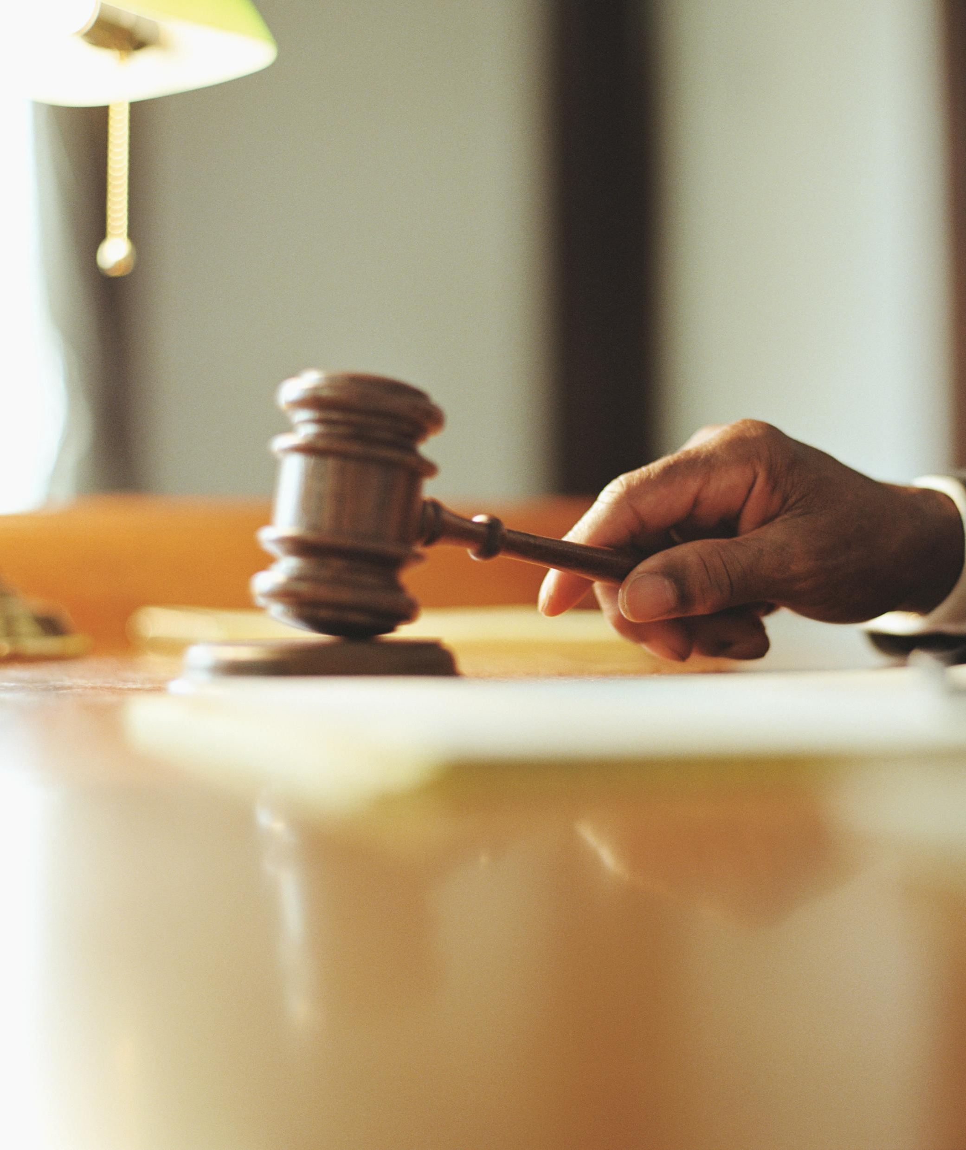
Call to Order
Time
Board Members in Attendance
HOA Members in Attendance
Proxies

Slide 3
Agenda
2024 Annual Meeting Minutes
2025 Review
Homeowner Education – Lou Hamm
Treasurer’s Report, 2026 Plan, and Budget Vote
Nominations for Open Board Seats and Vote
New Business

Slide 4
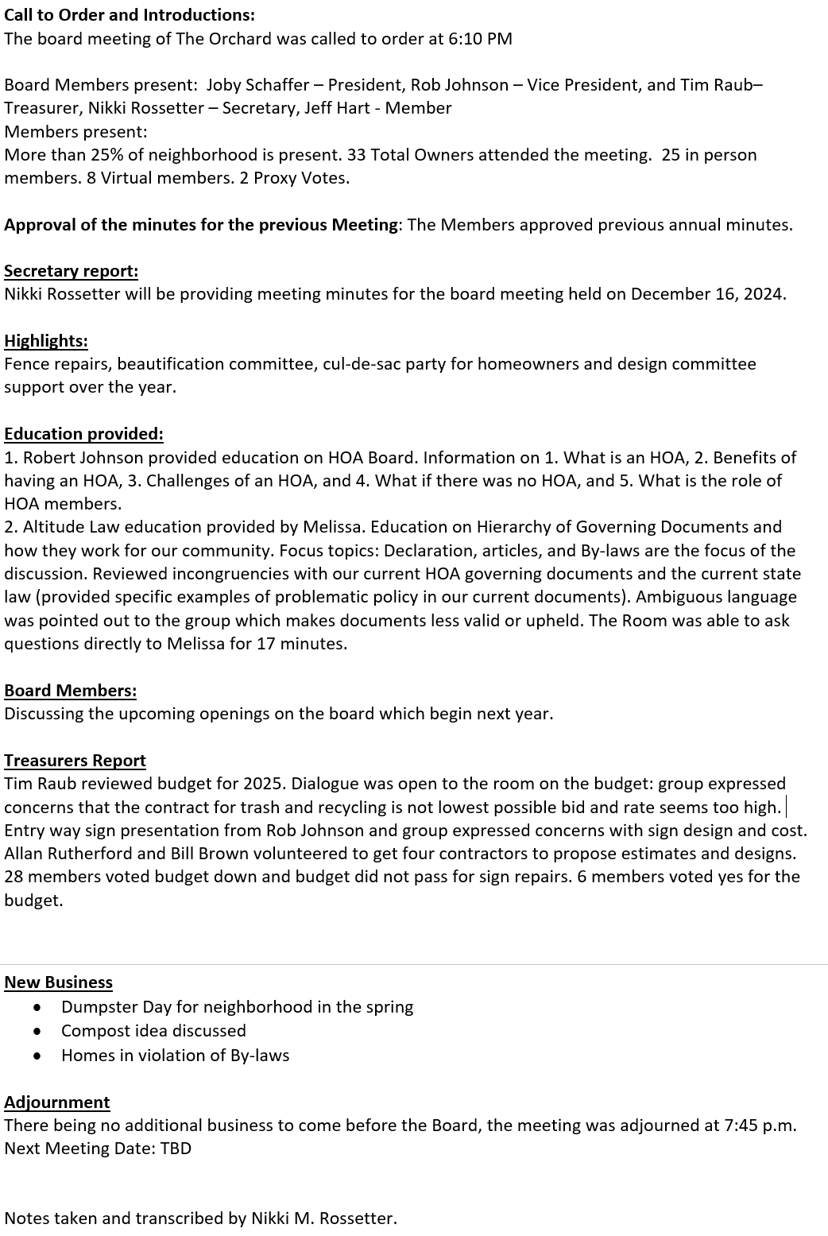
2024 Annual Meeting Minutes Approval
Motion to Approve…
All in Favor…

Slide 5
2025 Review
Board Actions
  Very few violations reported with few Board-required compliance engagements;
  Focus on core service provision (trash/recycling, landscaping, etc.) and minor enhancements (benches, bike rack);
  Routine Board work related to collections and registrations;
  Heavy focus on governing document rewrite project.

Slide 6
Governing Document Rewrite Project – Background & Timeline
Pre-2025
Altitude Writes Drafts at the Board’s Direction
Q1 2025
Board Review & Discussion with Altitude
Q2-3 2025
Q4 2025
Updated Drafts
Community Engagement
Revisions
Voting
Community Engagement Planning
Objective: Modernize Orchard Governing Docs to align to CCIOA, HOA best practices, and to fit the unique elements and preferences of our community.

Slide 7
All Governing Documents Were Approved
Voting concluded on Sunday, December 14th
The Board received 44 ballots out of 53 possible (83%)
Treasurer (Tim Raub) has hard-copies of the received ballots
Governing Doc. | Approval Needed | Approve | Reject | No Vote
Bylaws | Majority of a Quorum (23 votes out of 44 ballots) | 40 (91%) | 4 (9%) | 9 (N/A)
Articles | 2/3rd (36 votes out of 53 possible) | 42 (79%) | 2 (4%) | 9 (17%)
Declaration | 2/3rd (36 votes out of 53 possible) | 38 (72%) | 6 (11%) | 9 (17%)

Slide 8
Governing Docs – Next Steps
File the documents
  Declaration must be notarized, signed, and recorded with Jefferson County
  Articles field with the Colorado Secretary of State
  Update our website with the new documents
Conformity review and updates*
  Policy and Procedure Manual
  Architectural Standards
  *Changes require a majority vote of the HOA Board

Slide 9

Homeowner Education
Lou Hamm

Slide 10
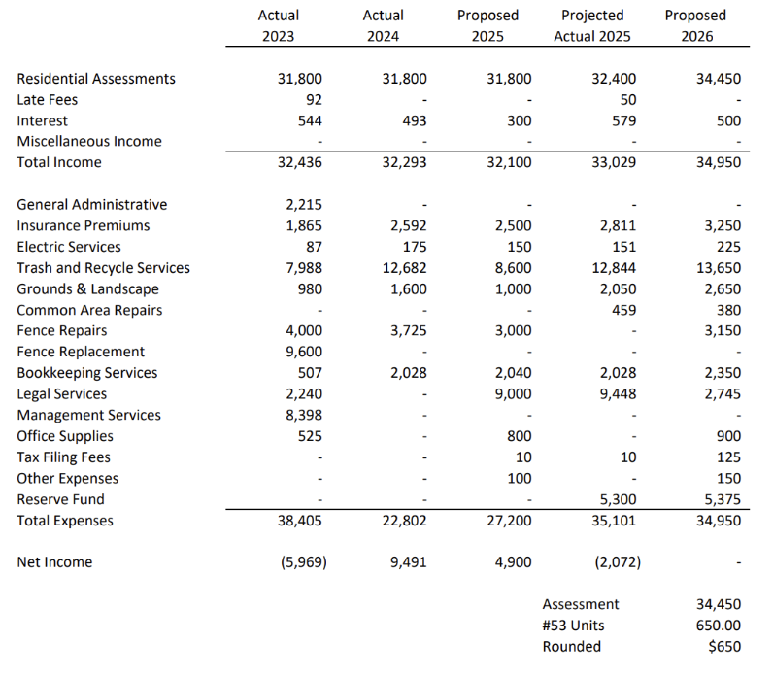
Treasurer’s Report + 2026 Plan/Budget
Any motions?

Slide 11


Nominations for Two Open Board Seats
Jeff Hart
Rob Johnson
Term: 2024-2026
Term: 2024-2026
Joby Schaffer
Nikki Rossetter
Tim Raub
Term: 2024-2026
Term: 2023-2025
Term: 2023-2025

Slide 12

Board Seat Vote (secret ballot if contested)
All in Favor…

Slide 13

New Business
Questions?

Slide 14

Happy Holidays!

